Slide 1
Predicting Loyalty at Turtle Games
Presented by: Raksha Nama, Data Analyst
Notes:
Hello everyone! I’m Raksha, a data analyst, and I’ll be presenting key insights from my analytical work for Turtle Games, a global game manufacturer and retailer.
Using customer sales and review data, we’ve identified patterns, predictions, and actionable insights that can help Turtle Games improve sales and strengthen customer loyalty.

Slide 2
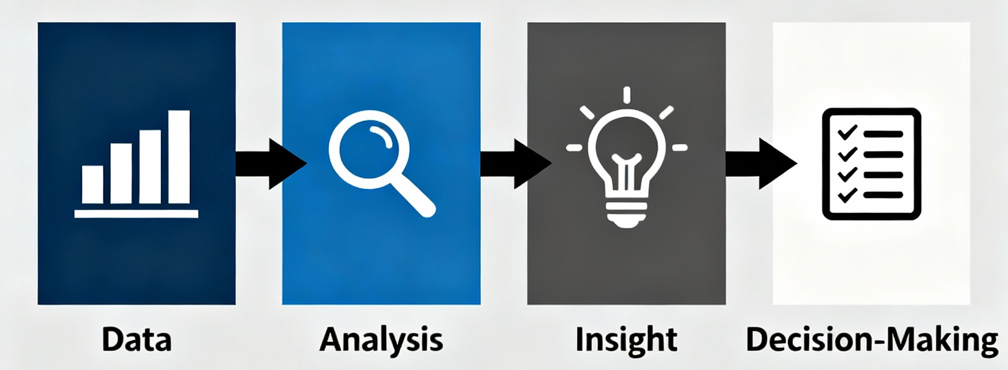
Business Context
Objective: Improve overall sales performance through data-driven insights.
Business Questions:
How do customers engage with and accumulate loyalty points?
How can customers be segmented for targeted marketing?
How can reviewing text data guide marketing improvements?
Can loyalty data support predictive modelling?
Notes:
Turtle Games’ leadership team wants to better understand customer behaviour to enhance sales performance.
This study focuses on loyalty engagement, segmentation, customer sentiment, and the predictive potential of loyalty data.
These four business questions shaped our analytical approach.

Slide 3
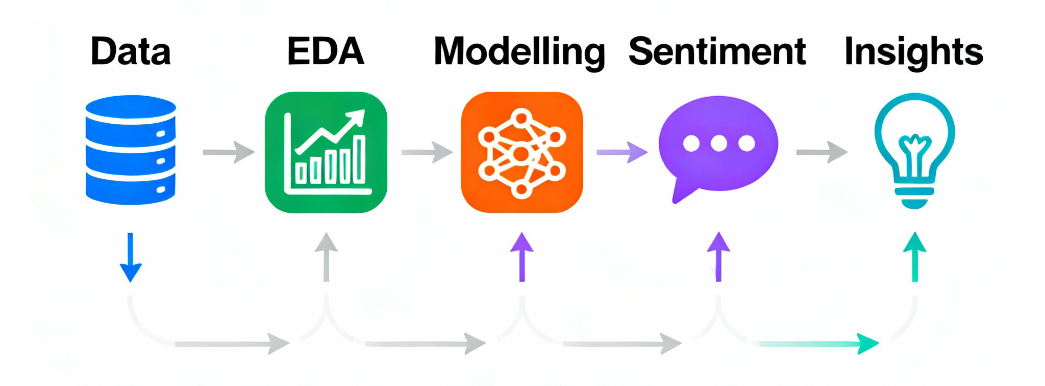
Analytical Framework and Techniques
Data Source: turtle_reviews.csv
Tools: Python, R
Key Methods:
Data Cleaning & Validation
Descriptive Statistics (distribution, skewness, kurtosis)
Multiple Linear Regression
Decision Tree Regression
K-Means Clustering
Sentiment Analysis (NLP)
Notes:
We applied a structured analytical framework combining quantitative and qualitative techniques.
Descriptive statistics helped assess the suitability of loyalty data for predictive modelling, while regression and decision trees quantified relationships.
Clustering segmented customers and sentiment analysis provided context on customer perceptions.
Together, these approaches enabled a 360-degree view of customer behaviour.
Justification:
Statistical tests quantified relationships.
Clustering identified customer segments.
NLP captured qualitative insights from reviews.

Slide 4
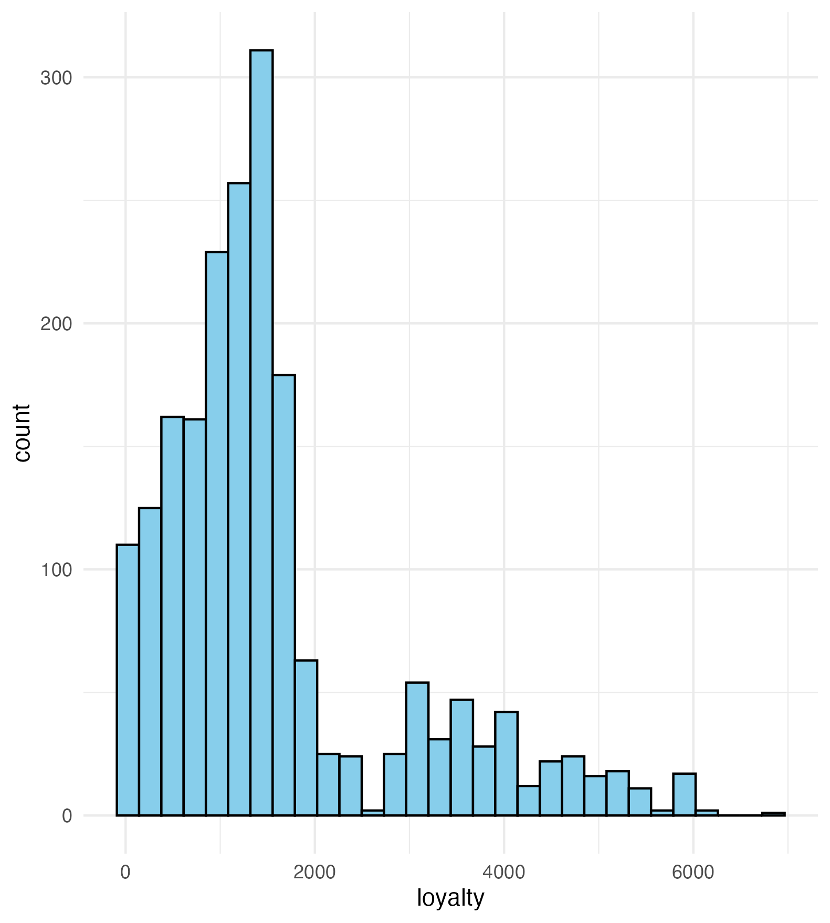
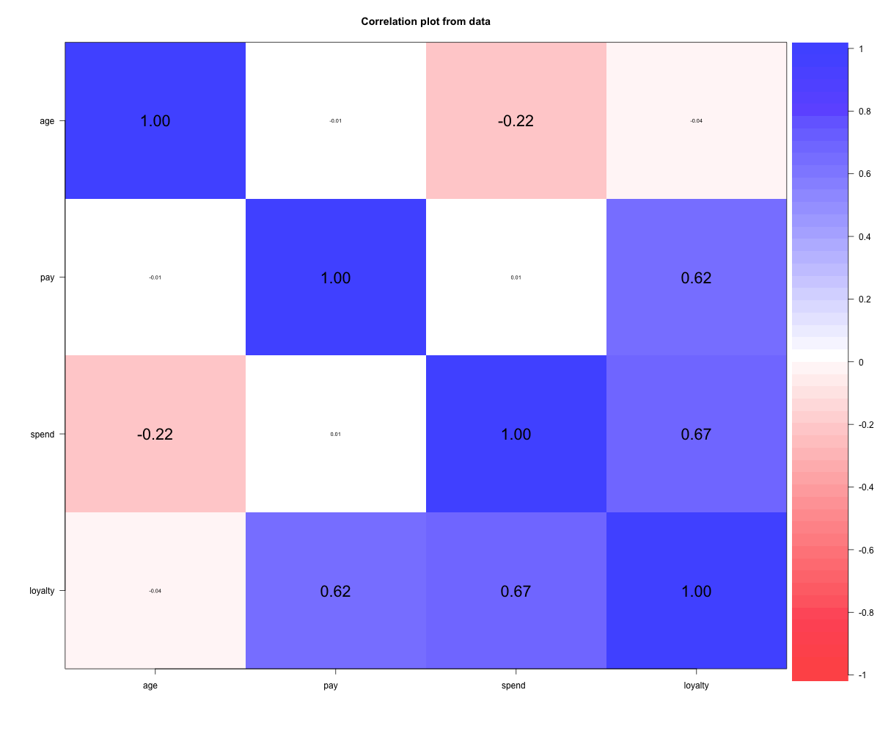
Data Suitability
Loyalty points: mild right skew, moderate kurtosis → acceptable for regression after outlier handling
Correlation highlights: spend–loyalty r = 0.67, pay–loyalty r = 0.62
Age–spend correlation: r = −0.22
Notes:
The distribution is mildly right-skewed but broadly suitable for regression after removing extreme outliers.
Correlations show spending has the strongest link to loyalty (r = 0.67), with pay also strong (r = 0.62).
Age correlates negatively with spending (r = −0.22), implying younger customers spend more

Slide 5
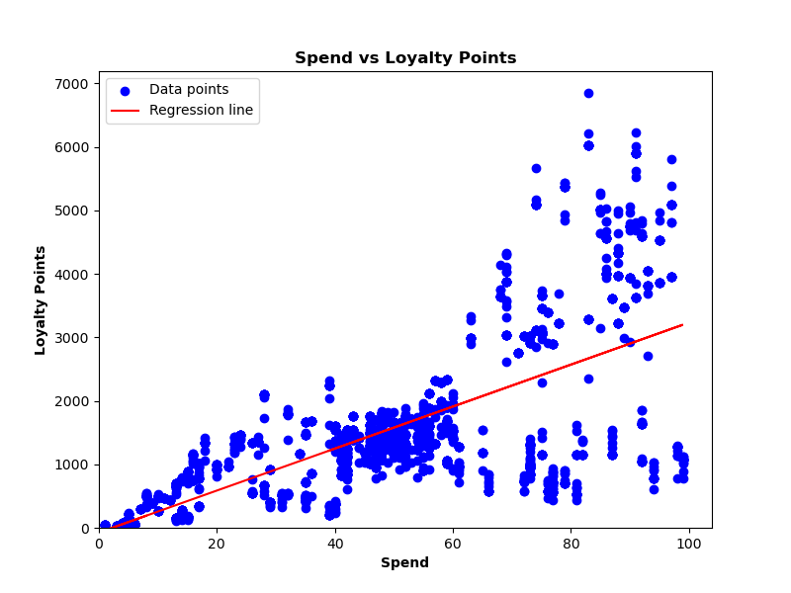
Loyalty & Spending Patterns
Spending & pay are strongly tied to loyalty accumulation
Most customers earn moderate points; a smaller high-value group drives much of loyalty
“Stretch spenders” (lower pay, higher spend) exist and are a strategic opportunity
Notes:
This scatterplot shows the clear positive relationship between spending and loyalty.
Most customers cluster at moderate loyalty levels, but a small set of high-value customers accumulates many points.
We also identified ‘stretch spenders’ — people with lower reported pay but high spending — who are a promising audience for promotions because they already demonstrate high engagement.

Slide 6
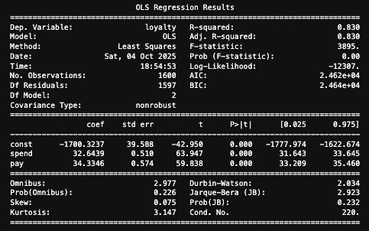
Regression & Predictive Performance
Model: Multiple Linear Regression with Pay and Spend as predictors
Key metric: Adjusted R² = 0.83 (model explains 83% of loyalty variation)
Coefficients summary:
Pay: positive significant
Spend: positive significant
Notes:
“When we modelled loyalty mathematically, income and spending emerged as the dominant drivers.
Our model explains 83 percent of loyalty variation — meaning Turtle Games can confidently forecast engagement and design rewards that reinforce it

Slide 7
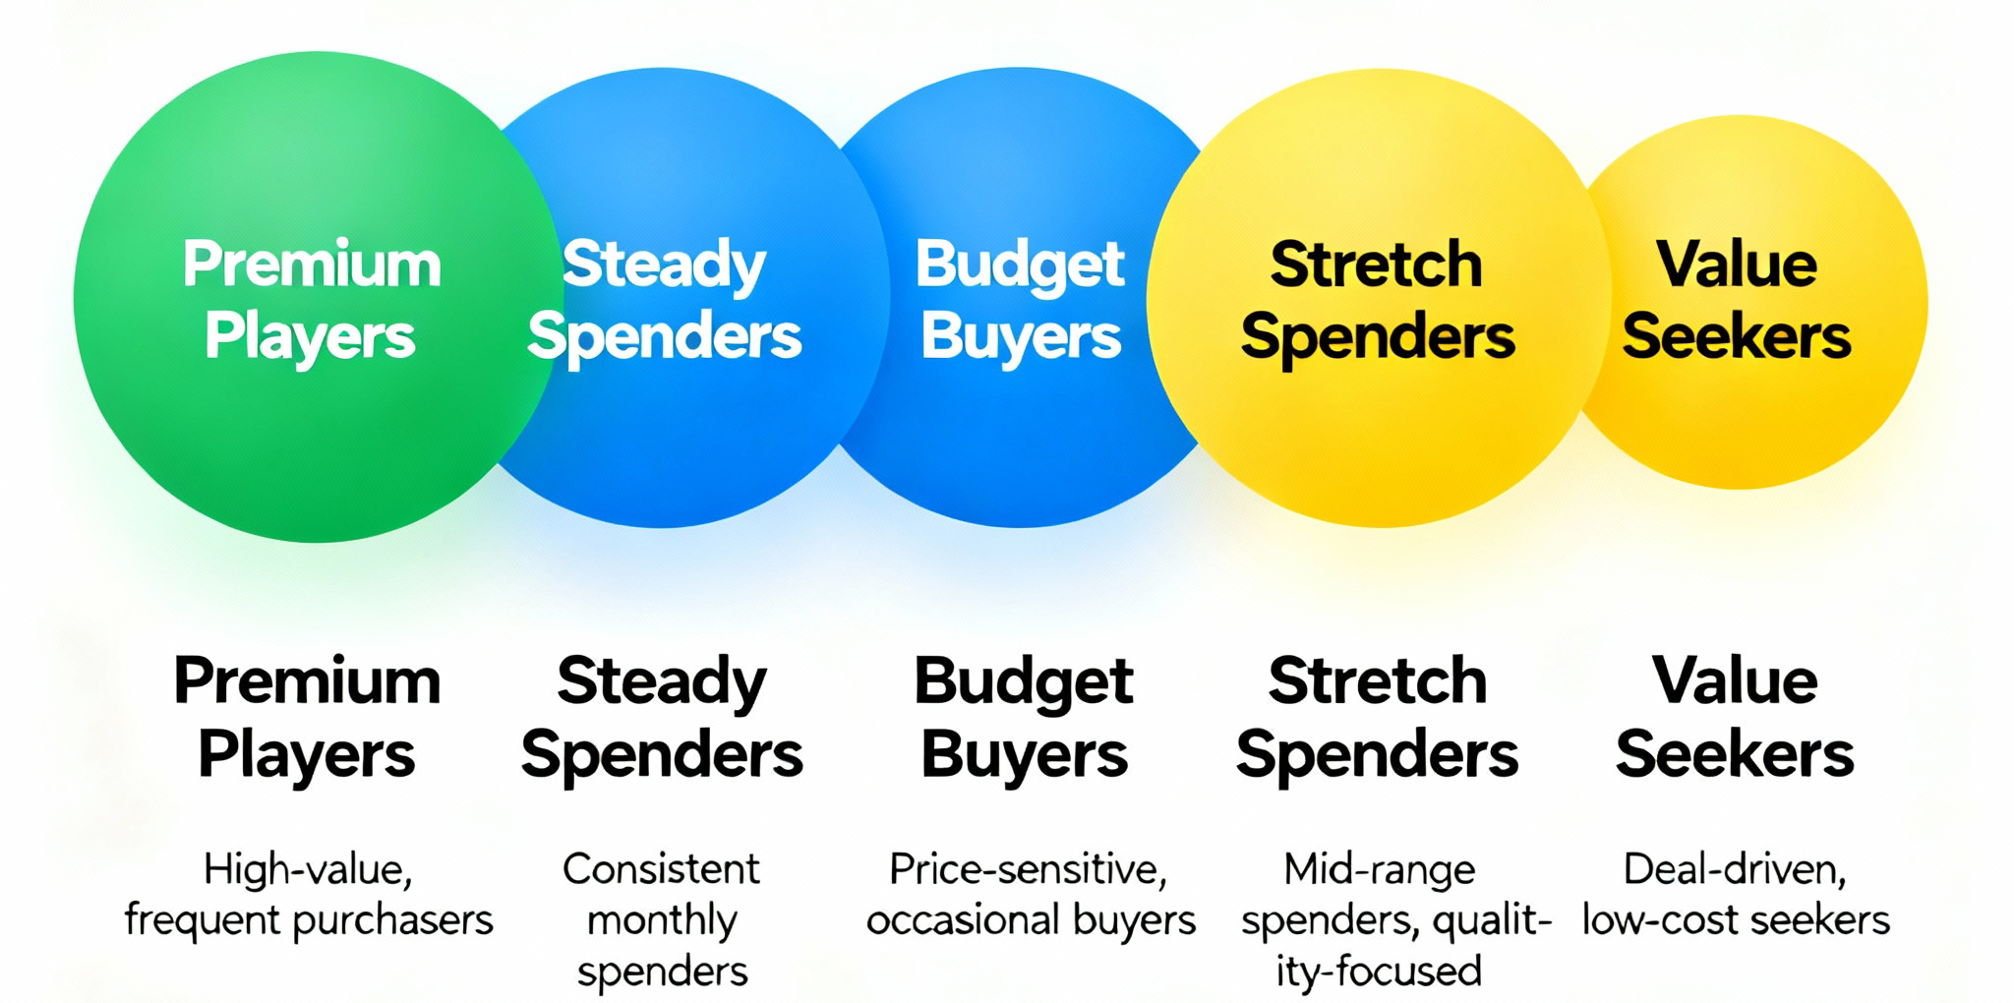
Customer Segmentation
Premium Players – high income & spend; top loyalty.
Steady Spenders – middle income; reliable base.
Budget Buyers – low income; price-sensitive.
Stretch Spenders – lower income, high spend; growth potential.
Value Seekers – mid-income, moderate spend; respond to deals.
Notes:
Clustering grouped customers into five easy-to-recognise personas.
Premium Players drive profit;
Steady Spenders sustain volume.
Budget Buyers are value-driven;
Stretch Spenders over-index on enthusiasm; and Value Seekers react well to offers. Each group warrants a tailored strategy.

Slide 8
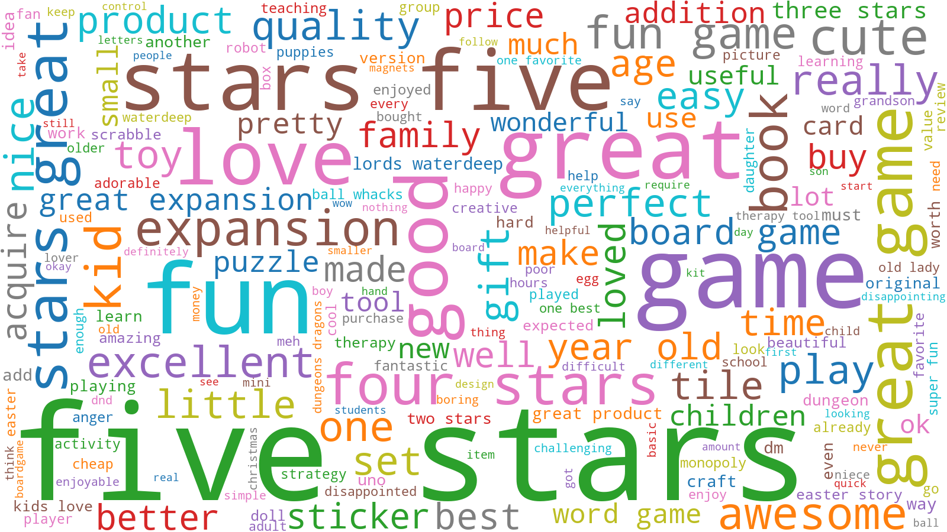
What are Customers Saying?
Positive feedback: “Fun,” “Great,” “Family,” “Love,” “Good value.”
Negative feedback: “Quality,” “Bad”, “Poor”, “Delivery”
Most reviews are positive— strong brand sentiment overall.
Opportunities: improve product quality.
Notes:
Customer feedback is mostly positive — people describe Turtle Games products as fun, great value, and family-friendly.
However, the negative comments focus on quality and delivery.
That means customers love our games, but frustration starts when products don’t meet expectations.
Fixing these operational issues could directly increase satisfaction and repeat purchasing

Slide 9
Key Patterns & Business Implications
What We Learned
Loyalty driven by spending & income.
Five clear customer segments identified.
Positive brand perception; service issues limit retention.
What It Means
Loyalty is predictable — we can forecast and influence it.
Segmentation enables targeted marketing.
Operational fixes will raise satisfaction and sales.
Notes:
In summary, loyalty is measurable and manageable. We can predict who will engage, segment customers precisely, and link feedback to actions that strengthen both loyalty and revenue.

Slide 10
Recommendations
Tiered Loyalty Programme – Bronze/Silver/Gold to reward and retain top customers.
Targeted Marketing – premium offers for high-value segments; affordable bundles for value seekers.
Operational Improvements – fix product quality, stock and delivery issues highlighted in reviews.
Predictive Planning – use loyalty models in CRM to forecast and personalise campaigns.
Data Enrichment – add region and frequency metrics to improve future accuracy.
Notes:
These five recommendations translate analysis into action.
A tiered programme will motivate every customer level.
Targeted marketing ensures relevance.
Fixing fulfilment issues will quickly lift satisfaction.
Integrating our models into the CRM allows proactive engagement, and richer data will sharpen predictions over time.

Slide 11
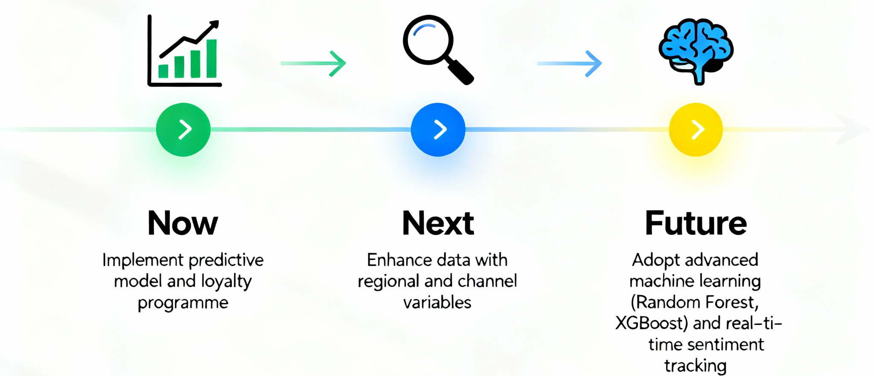
Future Steps & Conclusion
Extend the dataset with regional and channel information.
Test advanced models (Random Forest) for even better forecasting.
Continue real-time sentiment tracking.
Outcome: Loyalty is predictable and actionable — Turtle Games can now grow through data-driven decisions.
Notes:
“Next steps include expanding the dataset and using more advanced models to refine predictions, plus continuous monitoring of customer sentiment.
In conclusion, loyalty at Turtle Games is predictable and actionable. These insights give the company a clear roadmap to increase retention, satisfaction, and sales growth.

